Slide 1

A
Presentation Seminar On
Eye-Guided Mouse Control
The Future Of User Interface
Under the Guidance of:
Prof. A. A.Chaudhari
Presented by:
Mohammad Wasim Tikki
Mirza Awaise Baig
Mirza Umar Baig
Sourabh Meshram
Department of Computer Science & Engineering
Prof.Ram Meghe Institute of Technology and Research Badnera, Amravati

Slide 2

CONTENTS
INTRODUCTION
Problem Statement
Project Objective
Applications & Advantages
Conclusion
Algorithm

Slide 3
INTRODUCTION
Nowadays personal computer systems are carrying a huge part in our everyday lives as they are used in areas such as work, education and enjoyment.
While it is easy for a physically fit individual to interact with computers using keyboard and mouse, issue stands in front of specially abled people.
Controlling the mouse by a physically challenged person is really a tough one. To find a solution for the people who cannot use the Mouse physically, we have proposed this mouse cursor control using Eye Movements.
Eye gaze is an alternative way of accessing a computer using eye movements to control the mouse. For someone who fine touchscreens, mouse inaccessible, eye gaze is an alternative method to allow a user to operate their computer, using the movement of their eyes.

Slide 4
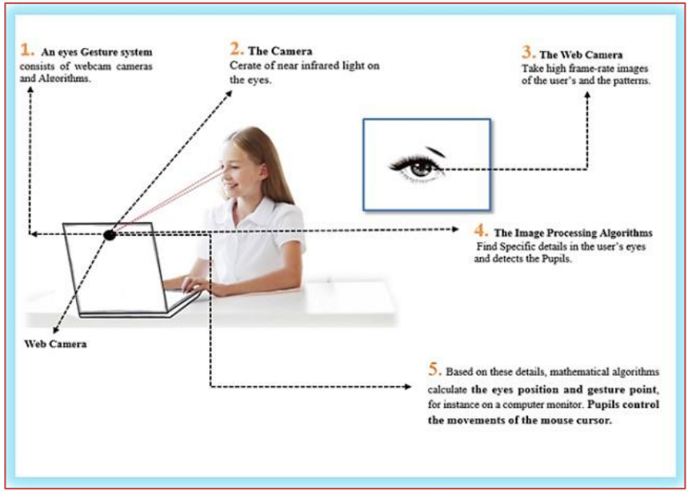

Slide 5
PROBLEM STATEMENT
As today, there are around 21 million people in India who are suffering from one or more than one physical disabilities which constitutes around 2 percent of India’s population.
In today’s era, computers have become a significant part of our lives. Such people cannot readily use the computer system.
Our problem is to develop a system which can help such people who are physically disabled but visually intact to use the computer system, so that their physical disability won’t hinder their abilities to use a computer.
Overall, the goal of this project is to develop a robust, user-friendly, and accessible eye tracking system that can be used by people with physical disabilities to improve their computer interaction experience.

Slide 6
PROJECT OBJECTIVE
The main objective of the "Eye-Guided Mouse Control" project is to develop a reliable and intuitive system for cursor control that uses eye-tracking technology to accurately capture and interpret the movement of the user's eyes.
To develop a reliable and accurate system for cursor control that uses eye tracking technology.
To enhance the accessibility and usability of computer interfaces for individuals with disabilities.
To explore the potential applications of eye-tracking technology in various fields.
To design an intuitive and user-friendly system for eye-based cursor control
To explore the potential applications of eye-tracking technology in various fields

Slide 7
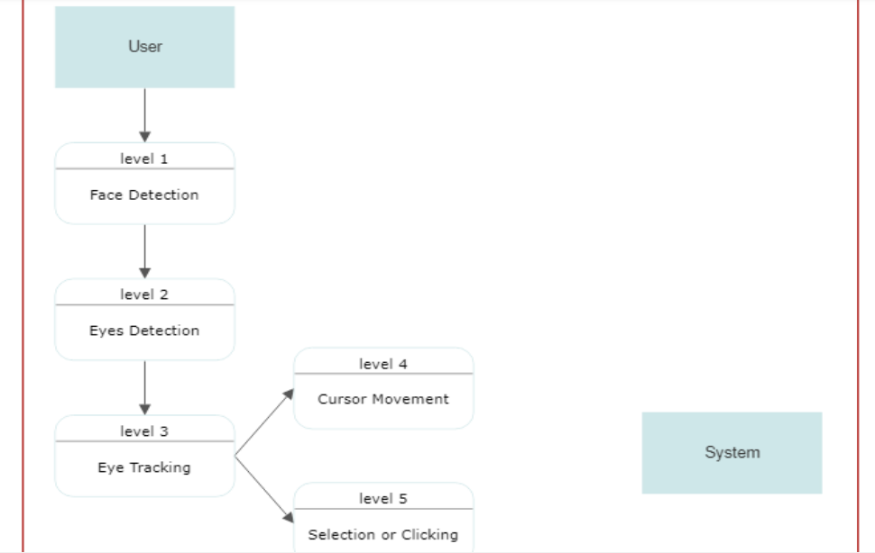
DFD DIAGRAM

Slide 8
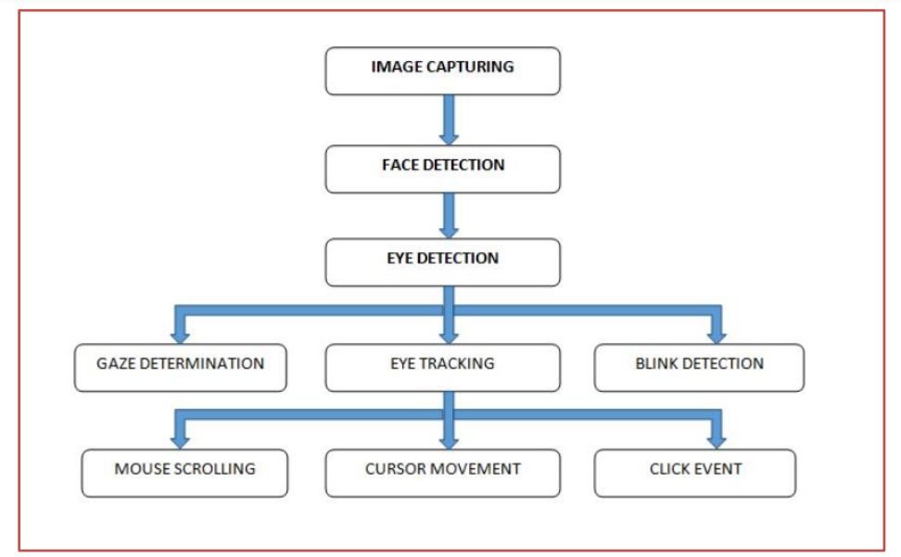
ALGORITHM
Decision tree regression is the fast algorithms which are commonly used in ensemble methods which is in the form of a tree structure. It is the process which breaks down a dataset into smaller and smaller subsets. The final result is a tree with decision nodes along with leaf nodes. numerical data. Regression trees are used to calculate the face’s critical positions directly from a pixel intensities which produces high quality.
Modules used:
Point of Gaze Calculation
Eye Features Detection
Pupil and Eye Corners
Aspect Ratio calculation

Slide 9
APPLICATIONS
Accessibility
Healthcare
Gaming
Education
Research
Industrial Design
Automotive
Virtual Reality

Slide 10
ADVANTAGES
Enhanced Accessibility
Precision and Control
Immersive Experience
Research and Development
Cost Effective
Flexibility

Slide 11
CONCLUSION
From the process implemented it is cleared that the cursor can be controlled by the eyeball movement i.e., without using hands on the computers. This will be helpful for the people having disability in using the physical parts of the computers to control the cursor points
The "Eye-Guided Mouse Control" system is a revolutionary technology that has the potential to change the lives of millions of people around the world. With its innovative approach to computer accessibility, the system provides a new way to interact with digital devices, allowing users to control the computer cursor with their eyes.
While there may be challenges in further refining the system's accuracy and responsiveness, the potential benefits are undeniable. The "Eye-Guided Mouse Control" system has the power to improve the lives of individuals with disabilities or mobility impairments, providing them with greater independence and access to digital society.
With its game-changing capabilities, the "Eye-Guided Mouse Control" system is truly a technology for the future.

Slide 12
THANKYOU

